Slide 1
Light Speed

Slide 2

By the end of this lesson, you should be able to:
State the speed of light.

Slide 3
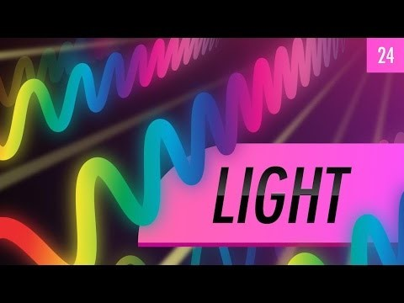

Slide 4
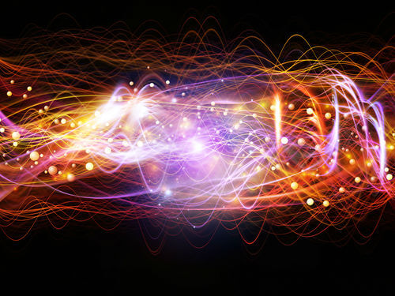
Almost all of the information we have about the universe comes from light.
Light is a form of energy that travels in waves called electromagnetic waves. Light has two parts, one electric and one magnetic, that are combined in the moving light, hence the name electromagnetic.

Slide 5
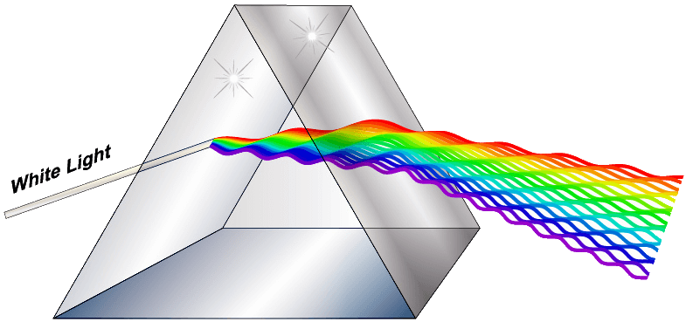
Because light is a wave, it has a wavelength. The energy of light depends on the light's wavelength.
Higher wavelengths of light have less energy, and lower wavelengths have more energy.
We can see the different energies of light through their colour. Red light has a long wavelength, purple has a short wavelength, and therefore purple light has more energy than red light.

Slide 6
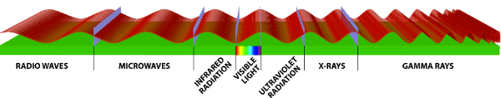
Our eyes can only see a small segment of light wavelengths.
There are much higher and lower wavelengths that we cannot see. We call this range of light the electromagnetic spectrum.
Radio waves, microwaves and infra red waves are all at lower wavelengths, and ultraviolet waves, x-rays and gamma rays are at higher wavelengths.

Slide 7
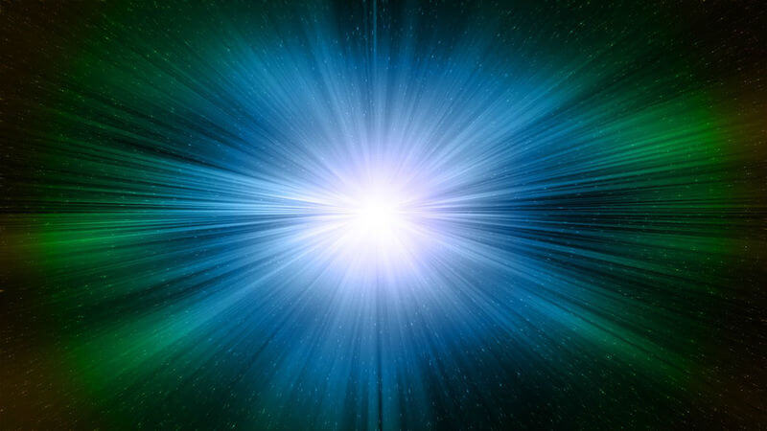
Light might seem like it moves from a lightbulb to your eyes instantly. But even light takes time to move, and as such it has a speed.
Light moves at 300,000,000 m/s.
This is fast enough that light moving anywhere on Earth seems instant. But in space, with such huge distances, it actually can take light quite a while to reach anywhere.

Slide 8


Slide 9

You see the plane before you hear it.
This is because light travels faster than sound, so the image of the plane reaches your eyes far quicker than the sound of the plane reaches your ears.
Sound travels at about 340 m/s.
Light travels at 300,000,000 m/s

Slide 10

You've probably noticed that you see things happening far away long before you hear them.
You always see a flash of lightning before you hear the thunder, for example.

